Slide 1
2020 TxACE Symposium Panel on Integrated Circuit Design in the Deep Learning Era
Public
Oct 19, 2020
Todd Younkin
President and CEO, SRC
todd.younkin@src.org

Slide 2
Todd Younkin Semiconductor Research Corporation
Slide 1 of 2
Emerging technologies require compute and communication efficiency that is orders of magnitude beyond what is available and readily imaginable. The opportunity is enormous.
Colossal complexity and scope for SoC/SiP designs on advanced nodes. A rapid increase in the number of physical design rules to account for and honor at all layers / components! (and violate! ☺) For example, chips now have ~10 million cell blocks as the new norm.
While pre-designed, functional IP blocks have been a wildly successful approach, as you start to stitch 100s-1000s of blocks together, engineers are losing insight into how to optimize SoC/SiP performance to seize market opportunities (in a timely fashion, C-SWAP). Choices also impacting business decisions and plans.
Public

Slide 3
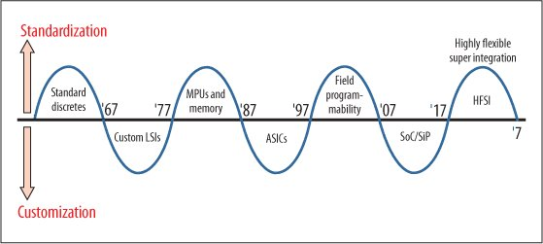
Todd Younkin Semiconductor Research Corporation
Slide 2 of 2
Productivity in engineering design / verification has not kept pace. Dramatic increases in costs and/or team sizes for development of leading-edge SoC/SiP designs is negatively impacting innovation and ecosystem gains. WE must expedite the design - verification - validation process. It will benefit all.
A deeply layered, transparent SoC/SiP development model based on ML/DL is required to drive industry innovation in cost effective, agile ways. We will see a Cambrian explosion of techniques / approaches. Rigor, understanding, and (peer) adoption will create winners that rise and become the standards of the near future.
Students and experienced engineers educated in this mindset (through both theory and application) will be in very high demand in the coming years. Workforce will grow, but the skillset will change.
J. Hruska Extreme Tech, Apr,’20
Public

Slide 4
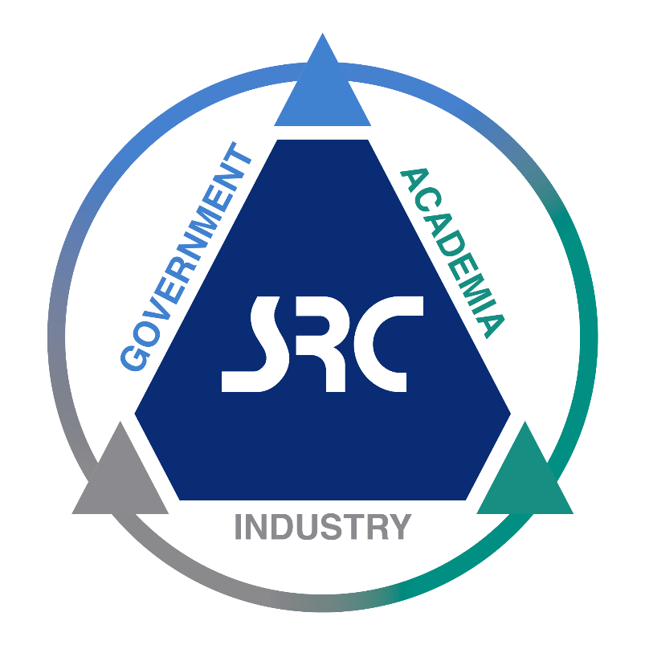
Public
Because the future can’t wait, we bring the best minds together to achieve the unimaginable
Learn more at www.src.org

